Slide 1
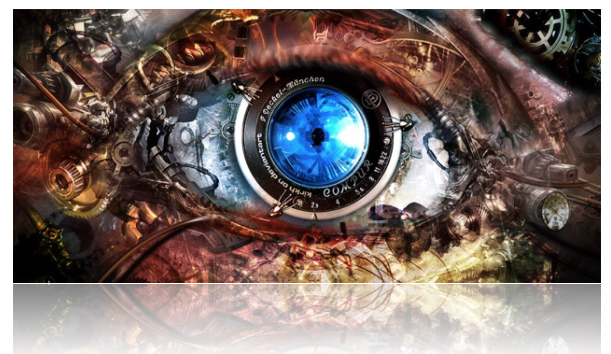
What is Computer Vision?
Computer Graphics: Models to Images
Comp. Photography: Images to Images
Computer Vision: Images to Models

Slide 2
Scope of CS 6476
Computer Vision
Robotics
Machine Learning
Human Computer Interaction
Image Processing Geometric Reasoning Recognition Deep Learning
Graphics
Medical Imaging
Computational Photography
Neuroscience
Optics

Slide 3
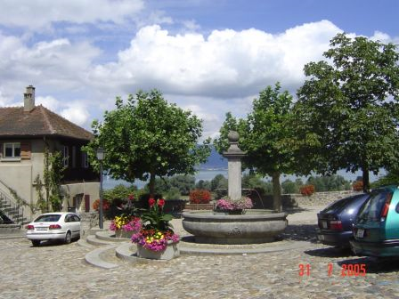
Computer Vision
Make computers understand images and video or any visual data.
What kind of scene?
Where are the cars?
How far is the building?
…

Slide 4
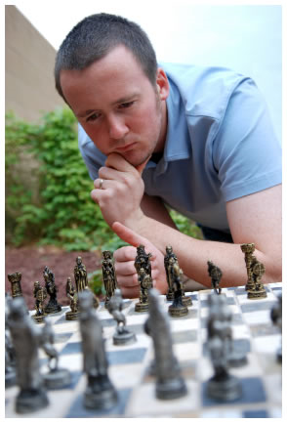
Vision is really hard
Vision is an amazing feat of natural intelligence
Visual cortex occupies about 50% of Macaque brain
One third of human brain devoted to vision (more than anything else)
Is that a queen or a bishop?

Slide 5
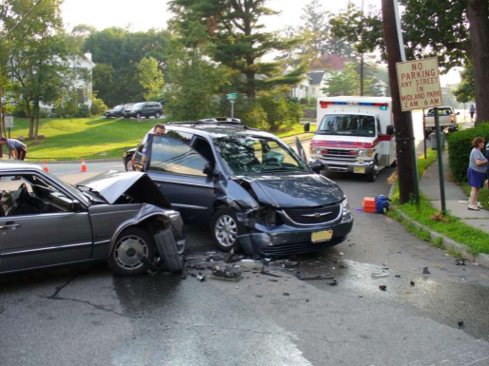
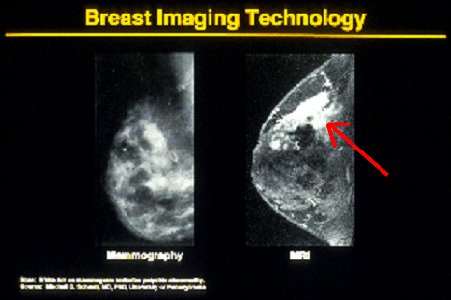

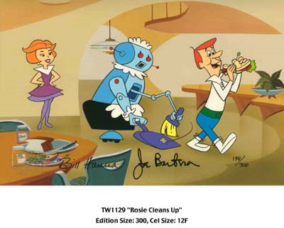
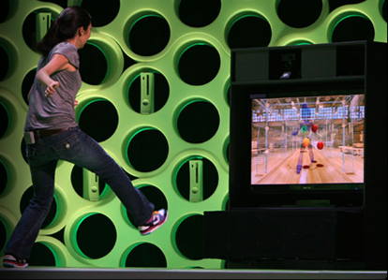
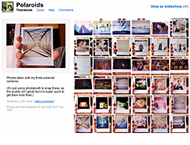
Why computer vision matters
Safety
Health
Security
Comfort
Fun
Access

Slide 6
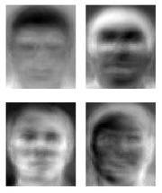
Ridiculously brief history of computer vision
1966: Minsky assigns computer vision as an undergrad summer project
1960’s: interpretation of synthetic worlds
1970’s: some progress on interpreting selected images
1980’s: ANNs come and go; shift toward geometry and increased mathematical rigor
1990’s: face recognition; statistical analysis in vogue
2000’s: broader recognition; large annotated datasets available; video processing starts
2010’s: Deep learning with ConvNets
2020’s: Widespread autonomous vehicles?
2030’s: robot uprising?
Guzman ‘68
Ohta Kanade ‘78
Turk and Pentland ‘91

Slide 7
How vision is used now
Examples of real world applications
Some of the following slides by Steve Seitz

Slide 8
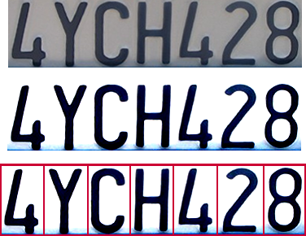

Optical character recognition (OCR)
Technology to convert scanned docs to text
If you have a scanner, it probably came with OCR software
Digit recognition, AT&T labs
http://www.research.att.com/~yann/
License plate readers
http://en.wikipedia.org/wiki/Automatic_number_plate_recognition

Slide 9
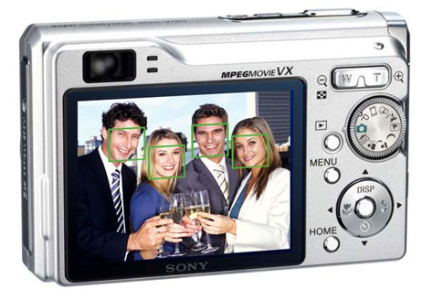
Face detection
Digital cameras detect faces
Notes:
Why would this be useful? Main reason is focus. Also enables “smart” cropping.

Slide 10
Smile detection
Sony Cyber-shot® T70 Digital Still Camera

Slide 11
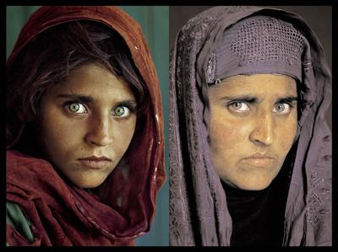
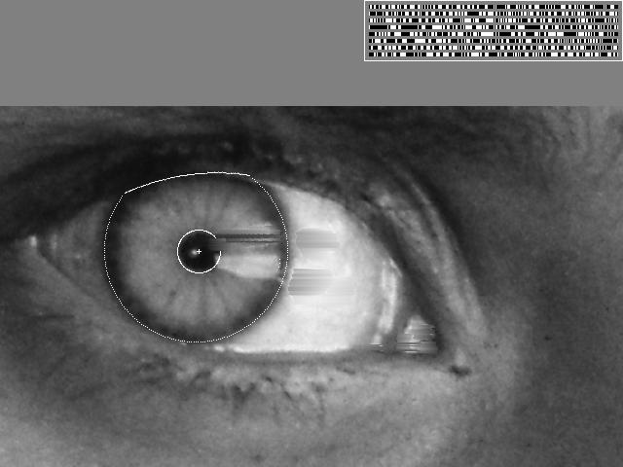
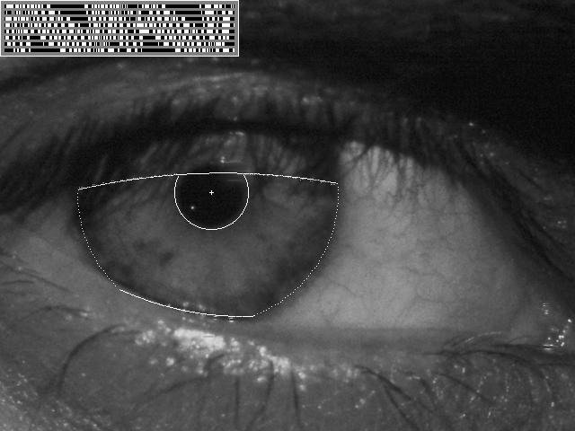
Vision-based biometrics
“How the Afghan Girl was Identified by Her Iris Patterns” Read the story
wikipedia
Notes:
Age 12, Age 30

Slide 12
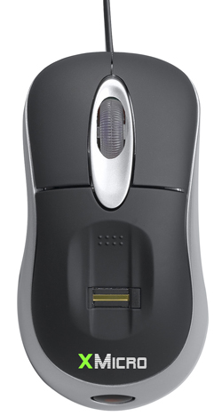
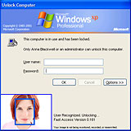
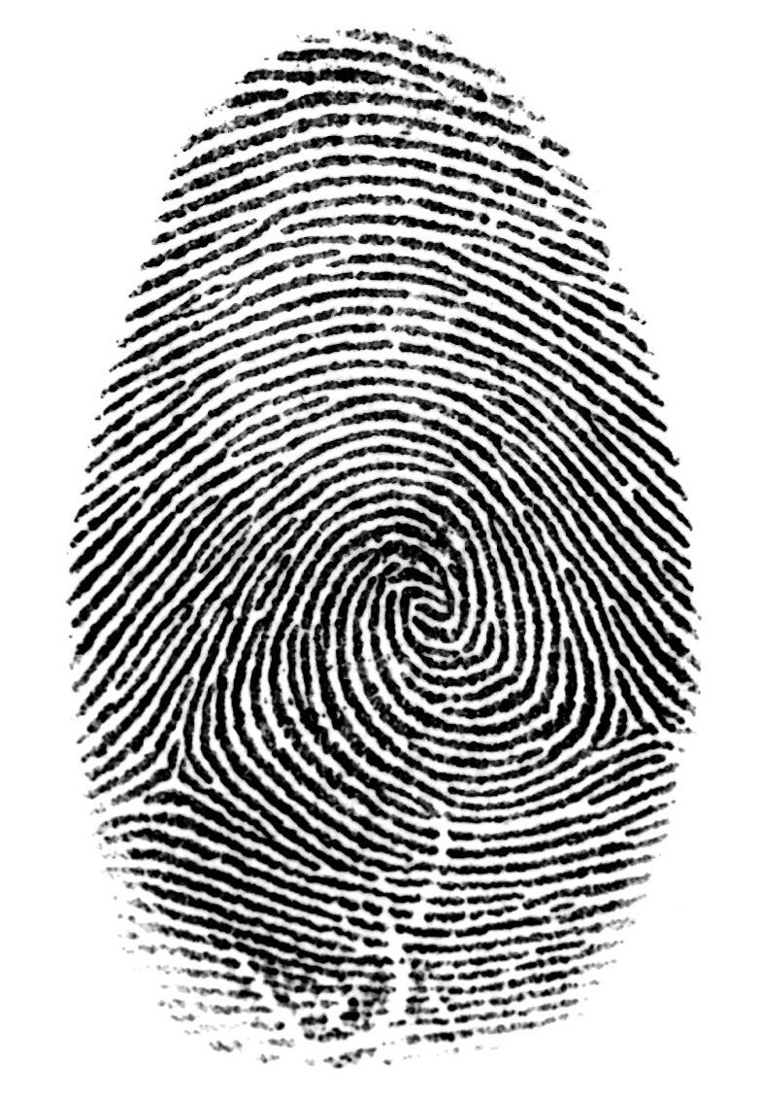

Login without a password…
Fingerprint scanners on many new laptops, other devices
Face recognition systems now beginning to appear more widely http://www.sensiblevision.com/

Slide 13
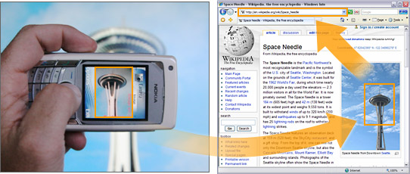
Object recognition (in mobile phones)
Point & Find, Nokia
Google Goggles

Slide 14
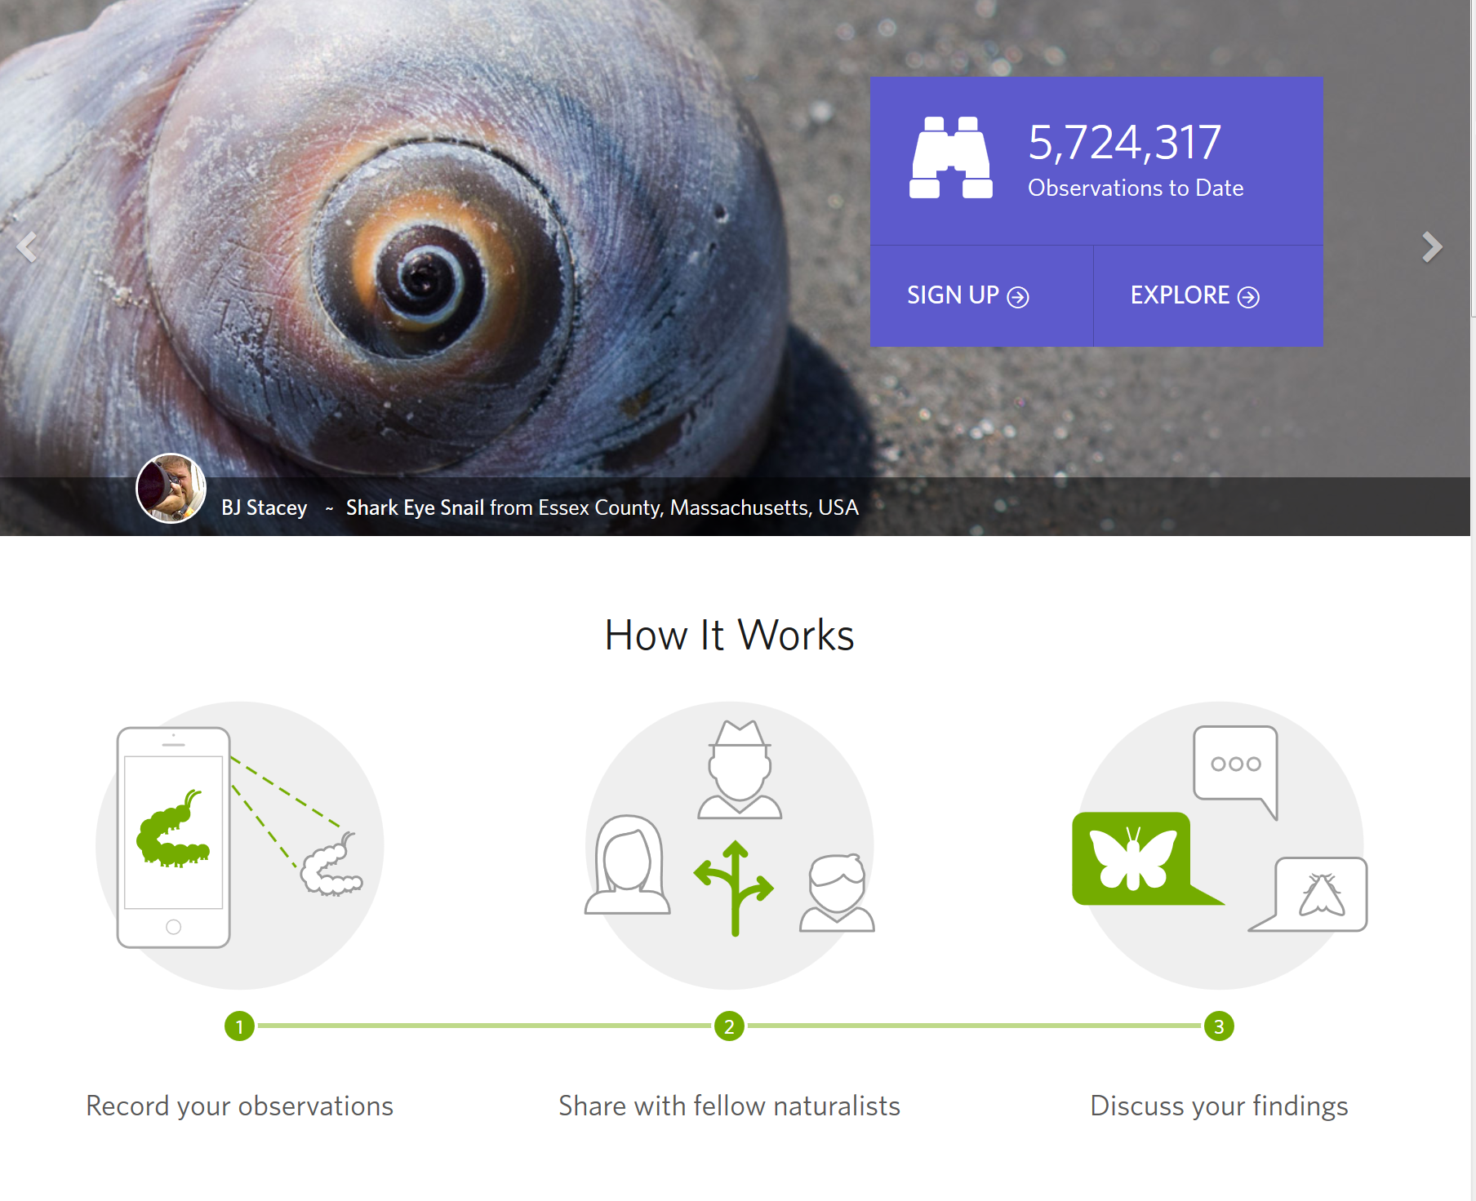
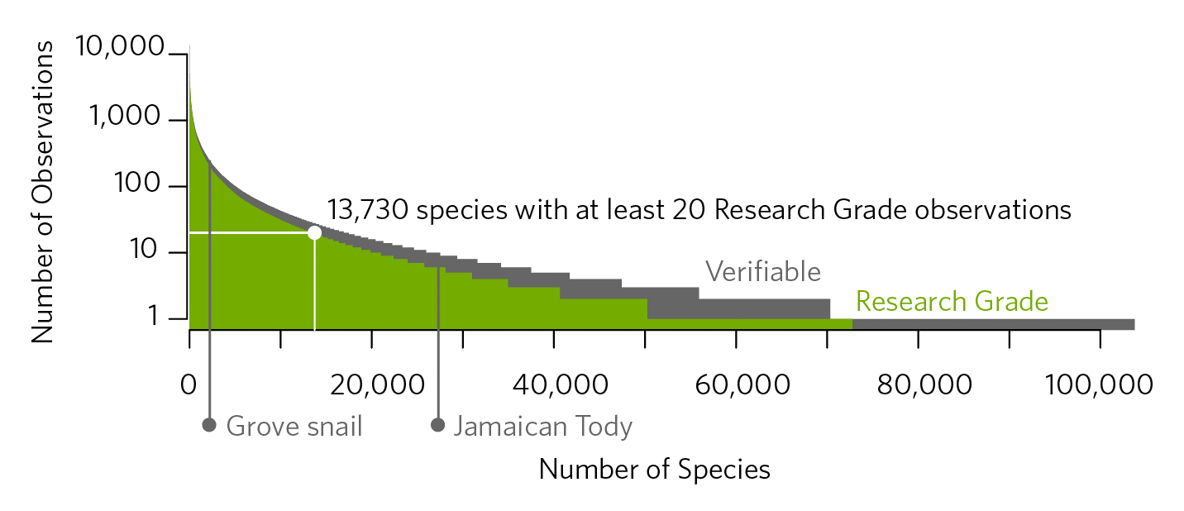
iNaturalist
https://www.inaturalist.org/pages/computer_vision_demo
Notes:
https://www.inaturalist.org/pages/computer_vision_demo

Slide 15
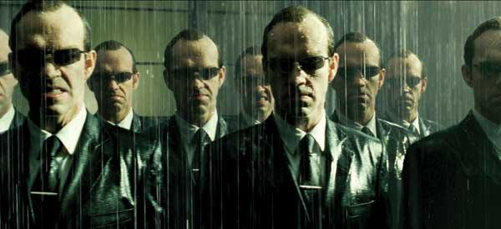
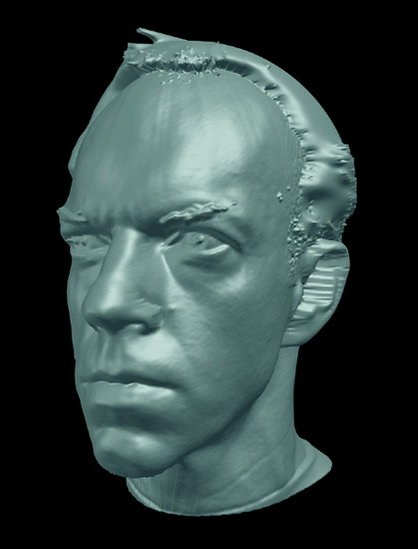
Special effects: shape capture
The Matrix movies, ESC Entertainment, XYZRGB, NRC

Slide 16
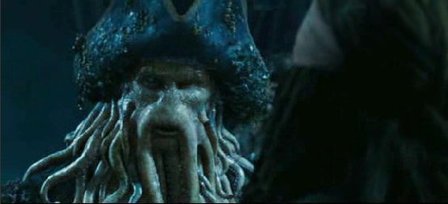
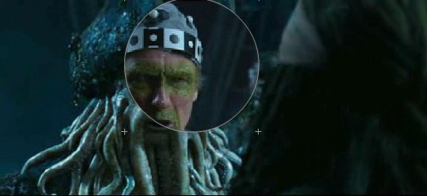
Special effects: motion capture
Pirates of the Carribean, Industrial Light and Magic

Slide 17
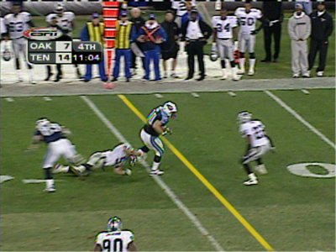
Sports
Sportvision first down line

Slide 18
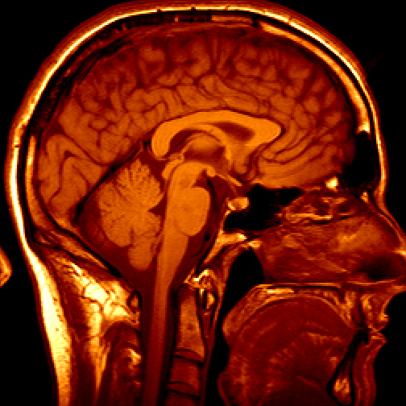
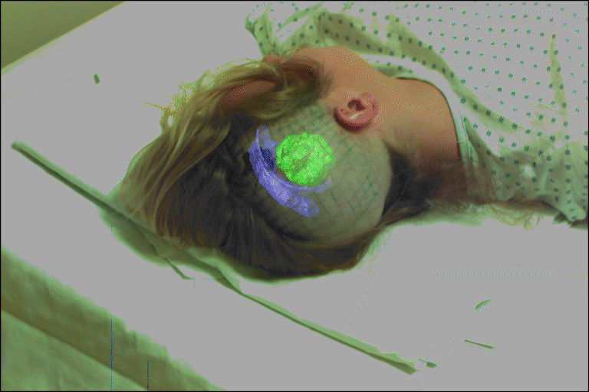
Medical imaging
3D imaging
MRI, CT
Image guided surgery
Grimson et al., MIT

Slide 19
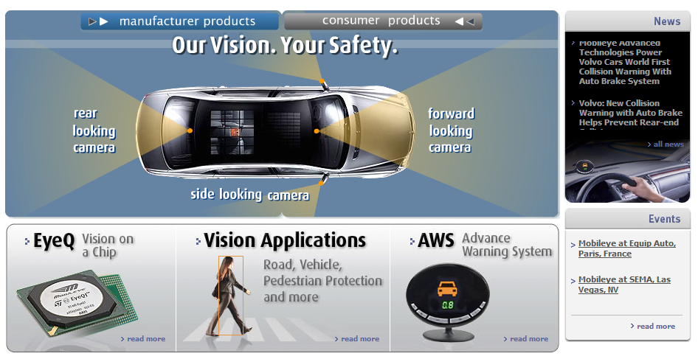
Smart cars
Slide content courtesy of Amnon Shashua
Mobileye
Market Capitalization: 11 Billion dollars
Bought by Intel for 15 Billion dollars

Slide 20
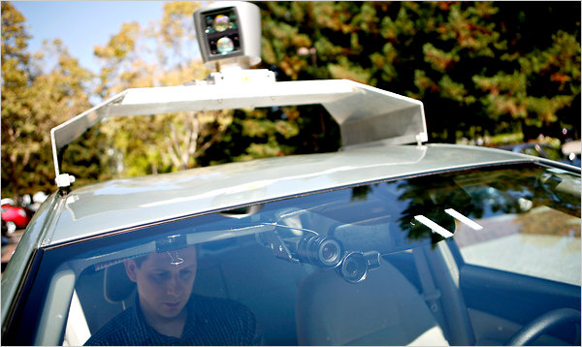
Google cars
Oct 9, 2010. "Google Cars Drive Themselves, in Traffic". The New York Times. John Markoff
June 24, 2011. "Nevada state law paves the way for driverless cars". Financial Post. Christine Dobby
Aug 9, 2011, "Human error blamed after Google's driverless car sparks five-vehicle crash". The Star (Toronto)

Slide 21
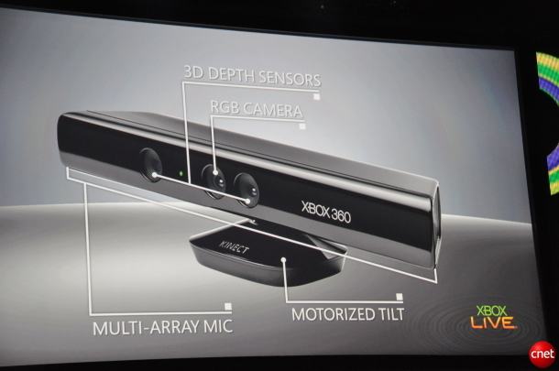
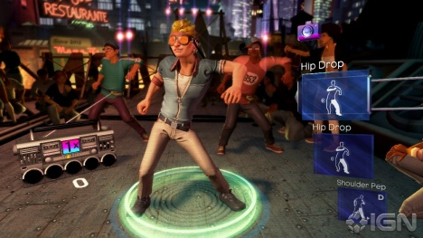
Interactive Games: Kinect
Object Recognition: http://www.youtube.com/watch?feature=iv&v=fQ59dXOo63o
Mario: http://www.youtube.com/watch?v=8CTJL5lUjHg
3D: http://www.youtube.com/watch?v=7QrnwoO1-8A
Robot: http://www.youtube.com/watch?v=w8BmgtMKFbY

Slide 22
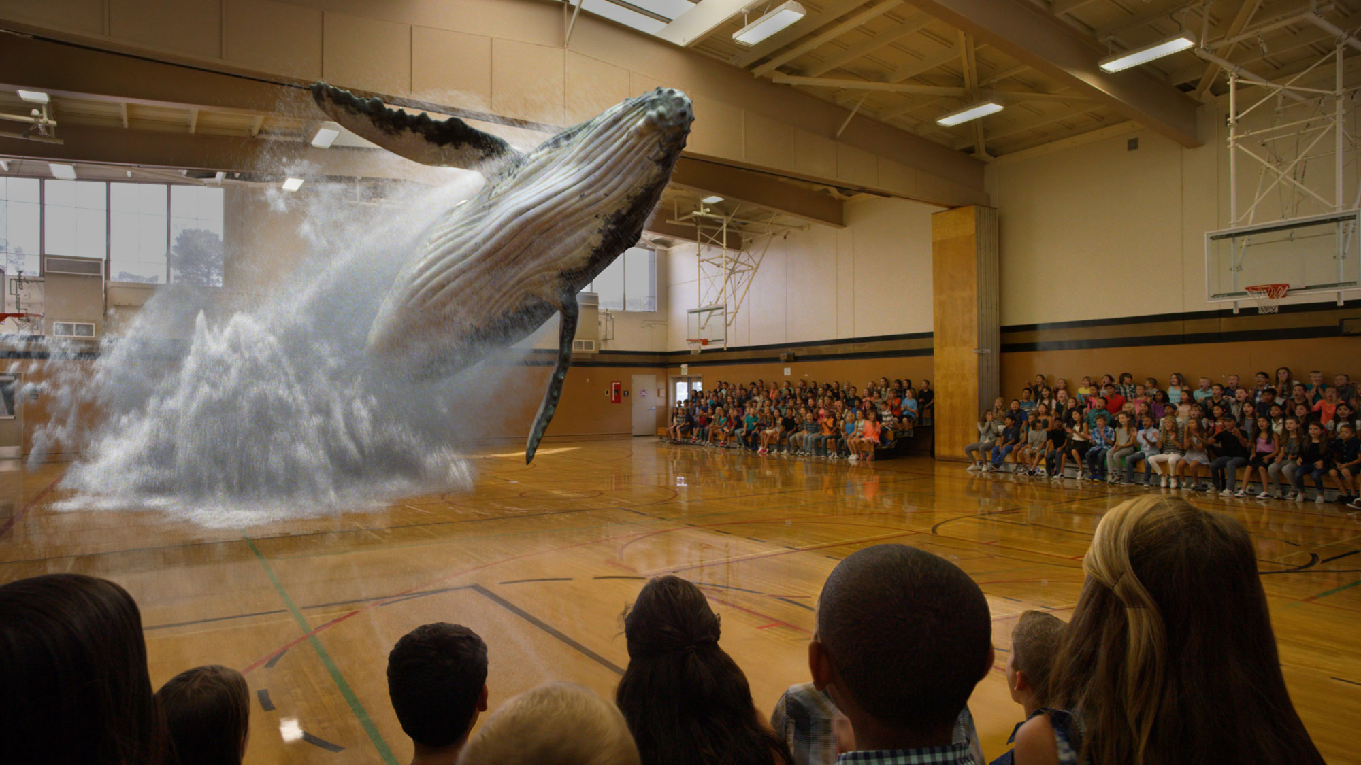
Augmented Reality and Virtual Reality
Magic Leap, Oculus, Hololens, etc.

Slide 23
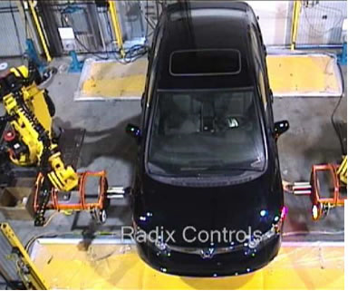
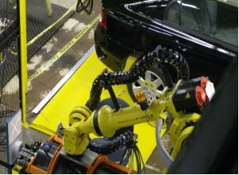
Industrial robots
Vision-guided robots position nut runners on wheels

Slide 24
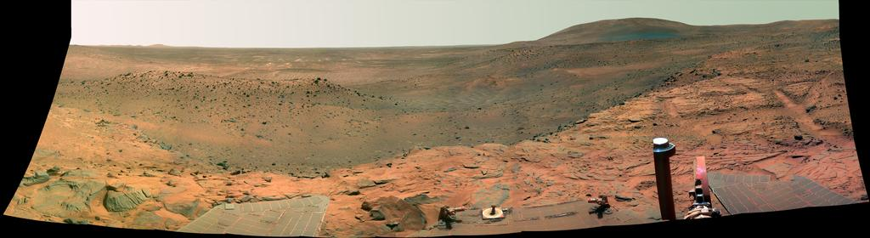
Vision in space
NASA'S Mars Exploration Rover Spirit captured this westward view from atop a low plateau where Spirit spent the closing months of 2007.
Vision systems (JPL) used for several tasks
Panorama stitching
3D terrain modeling
Obstacle detection, position tracking
For more, read “Computer Vision on Mars” by Matthies et al.

Slide 25
Amazon Prime Air
https://www.amazon.com/b?node=8037720011

Slide 26
State of the art today?
With enough training data, computer vision nearly matches human vision at most recognition tasks
Deep learning has been an enormous disruption to the field. More and more techniques are being “deepified”.

Slide 27


Slide 28
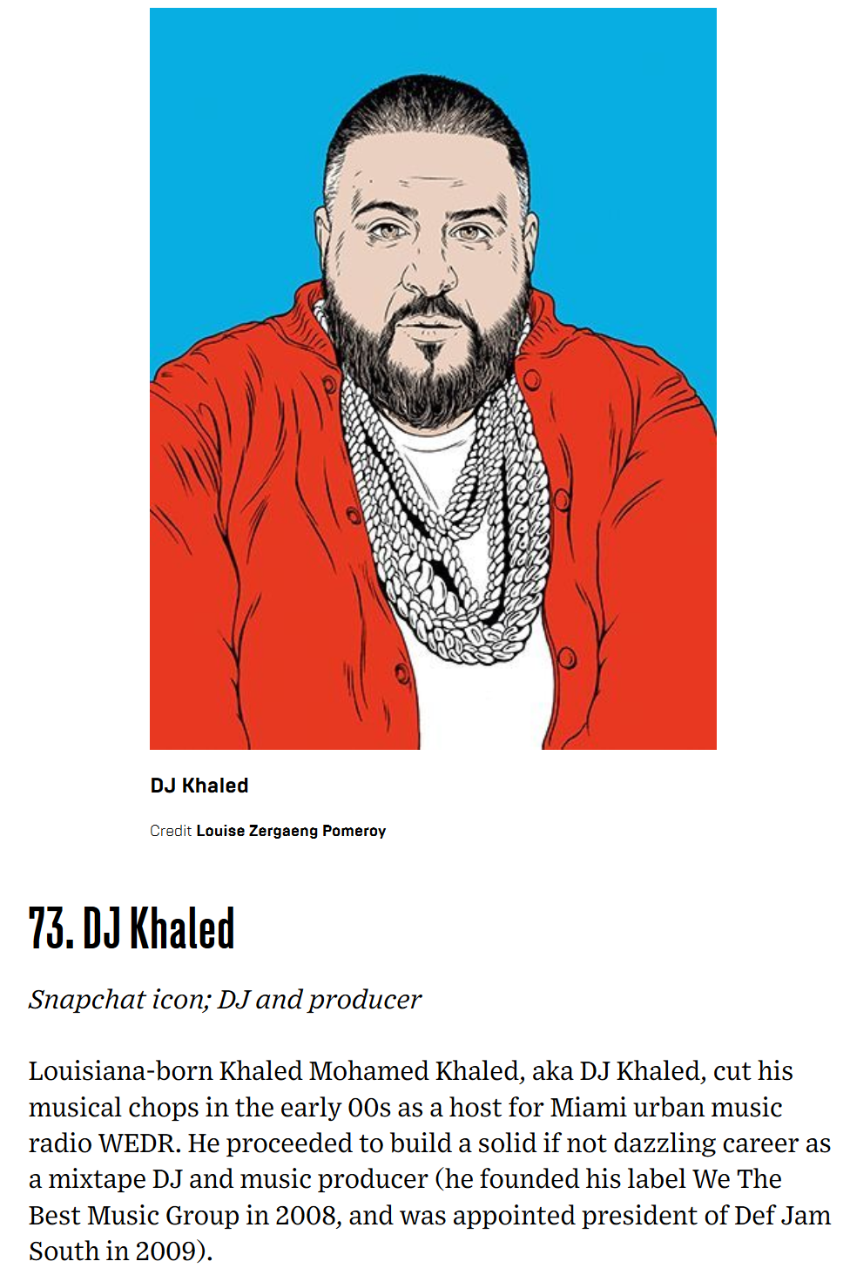

Slide 29
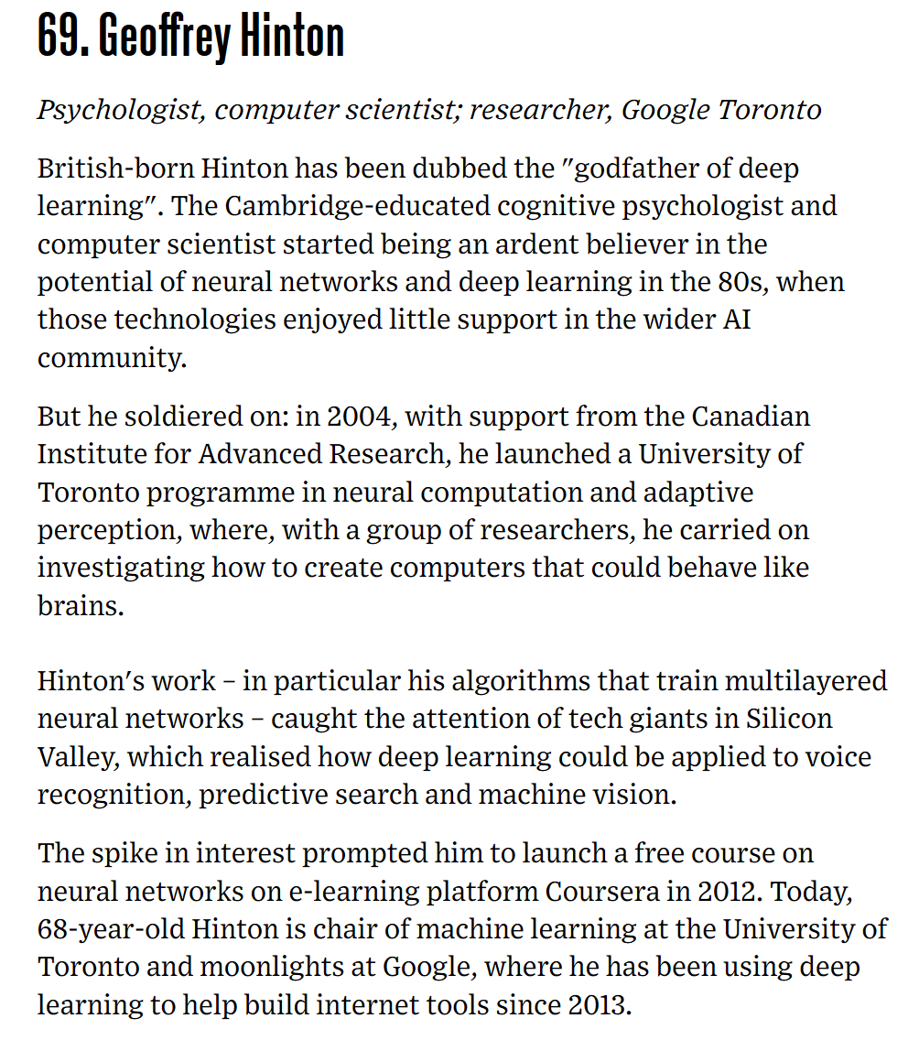

Slide 30
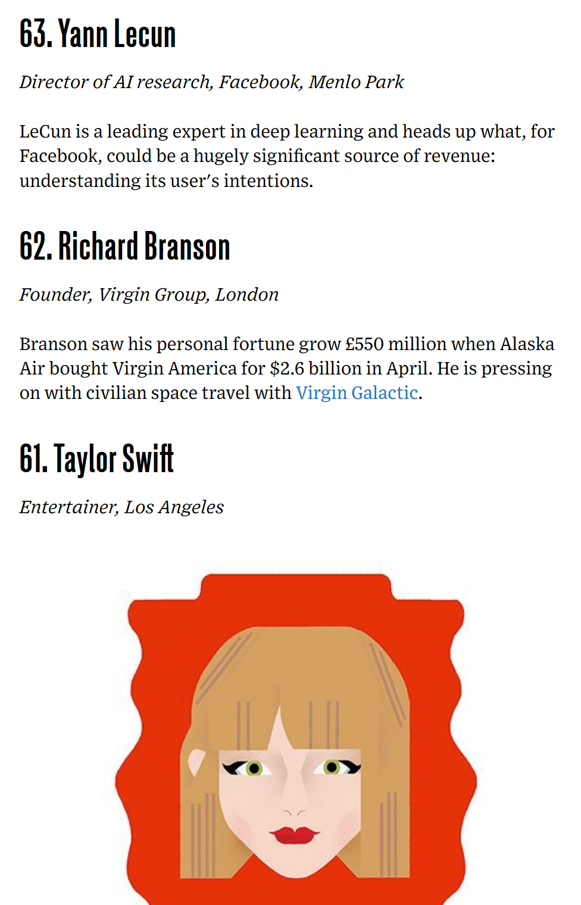

Slide 31
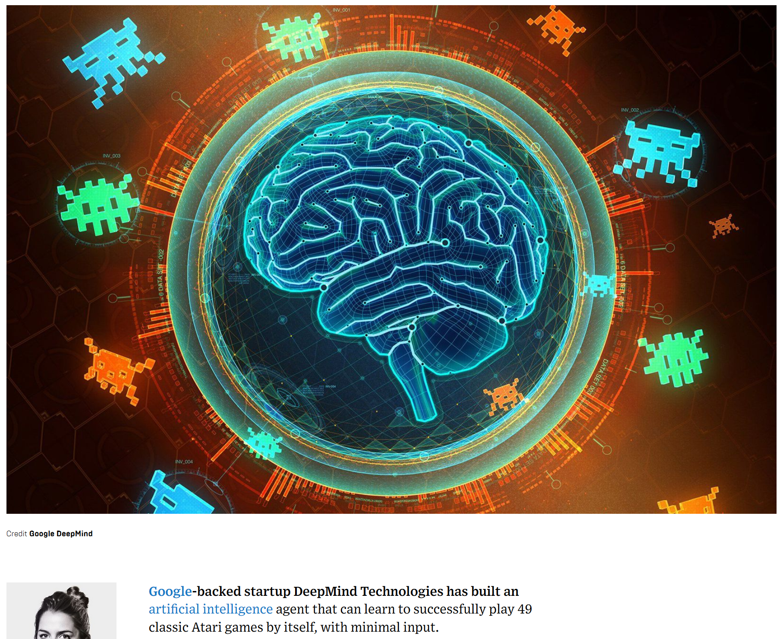

Slide 32
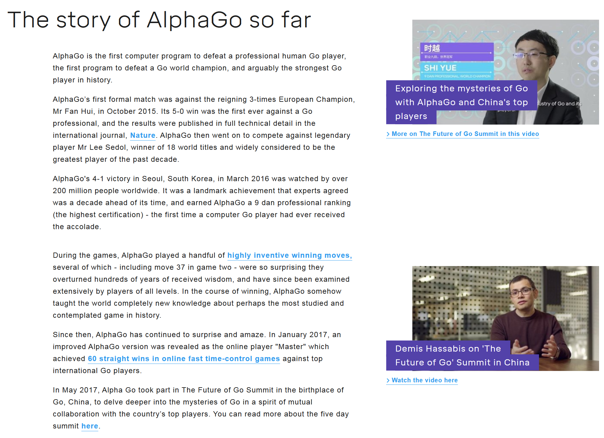

Slide 33
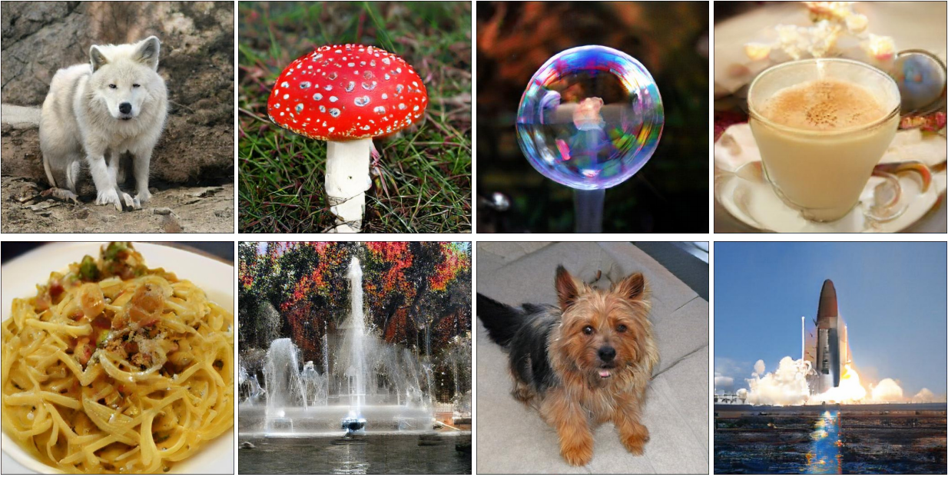
BigGAN
2018 Arxiv, ICLR 2019

Slide 34


This person does not exist
https://www.thispersondoesnotexist.com/

